Slide 1
Assessment of the dependence of the field shape on calibration coefficients in Dose Area Product (DAP) for small field sizes
J. Jurczakª, B. Rappª, S. Dufreneix^{b}, J. Gouriouª, F. Delaunayª, J-M Bordyª
ªUniversité Paris-Saclay, CEA, List, Laboratoire National Henri Becquerel (LNE-LNHB), F-91120 Palaiseau, France.
^{b}Department of Medical Physics, Integrated Center for Oncology, Angers, France.
July 29, 2021
Julien JURCZAK

Slide 2
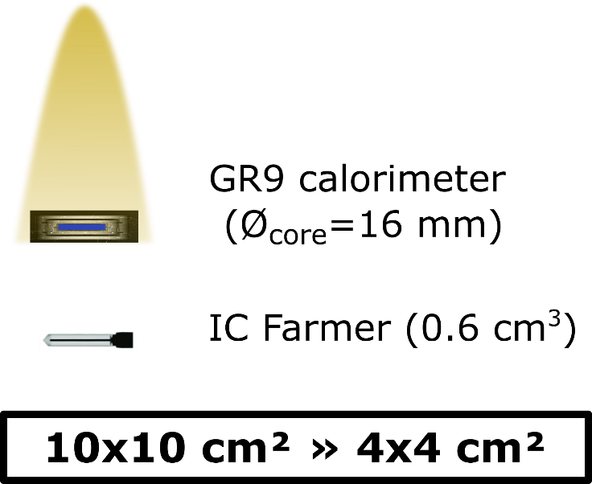
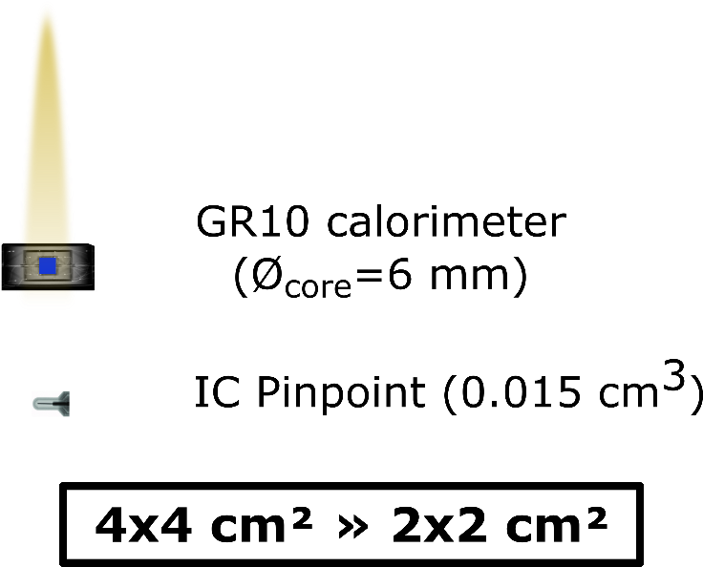
CONTEXT
No primary standards for small field sizes, far away from usual international protocols (TG51 - IAEA TRS 398 : absorbed dose to water at a point for a 10x10 cm² field size)
PURPOSE :
Establish the first primary standards for small fields to restore metrological traceability (< 2x2 cm²)

Slide 3
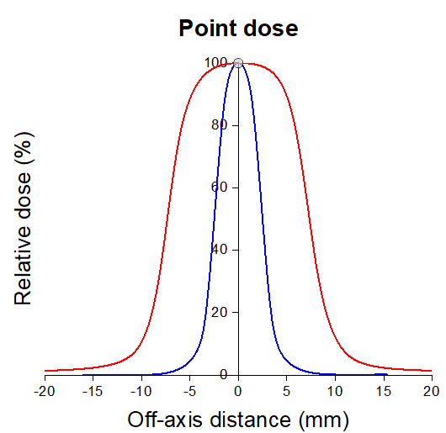
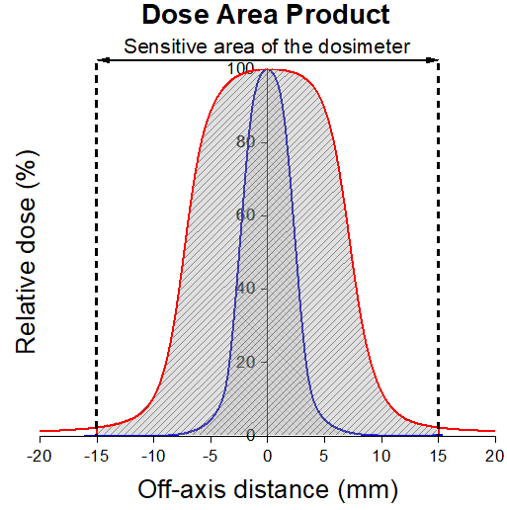
DOSE AREA PRODUCT (DAP) VS TRS 483
IAEA TRS 483 : use of detector and field size related correction factors for OF measurement
Correction factors increases uncertainty
Critical detector positioning
Need updates for new machines and new detectors
Is point dose still relevant in small fields ?
Introduction of another approach : the Dose Area Product (DAP)
5 mm field size (blue) and 15 mm field size (red)
Integration of the central axis output + the penumbra

Slide 4
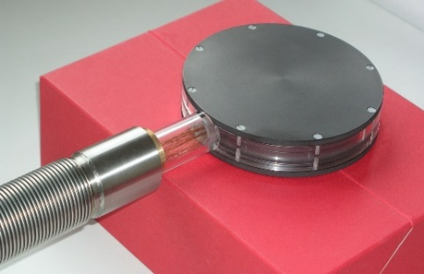
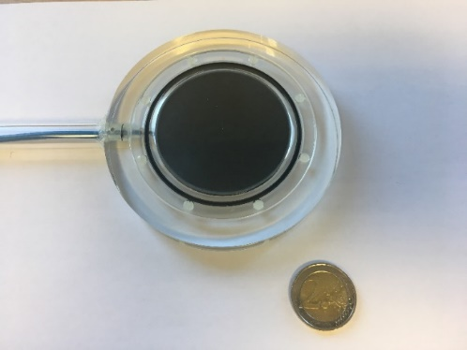
TRACEABILITY CHAIN FOR DAP
Design and construction of a 30 mm core diameter graphite calorimeter (S. Dufreneix thesis, LNHB, 2014) :
primary measurement standard
Design and construction of plane-parallel ionization chambers with the same sensitive area (this work) :
secondary measurement standard
GR11 calorimeter
DAP chamber
INVESTIGATION :
Dependence of the calibration coefficient N_{DAP,w} (Gy.cm².C⁻¹) with the size and the shape of the irradiation field

Slide 5
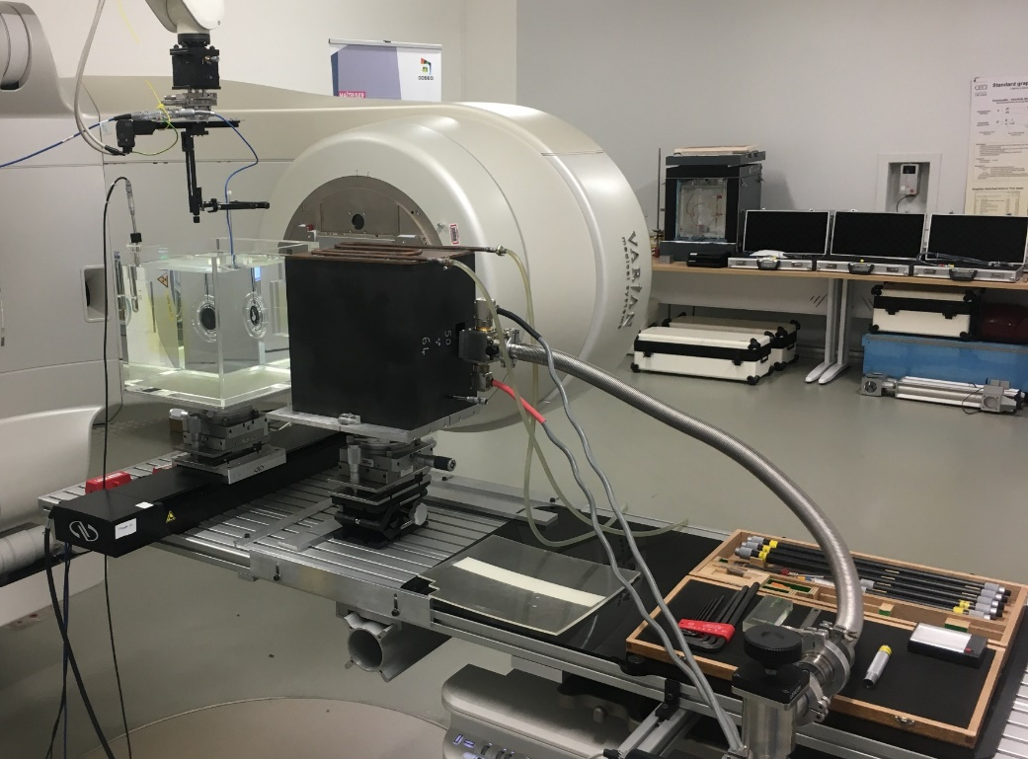
EXPERIMENTAL SETUP
DAP chamber
Water phantom (30x30x30 cm³)
GR11 graphite calorimeter inside its graphite phantom
4

Slide 6
COLLIMATION SYSTEMS AND FIELD SIZES
Field sizes with 2 collimation systems in a 6 MV FFF beam at the maximum dose rate of 14 Gy/min on a Varian TrueBeam of the DOSEO platform :
Jaws (square fields)
Custom collimators (circular fields)
5 – 7 – 10 – 13 – 15 mm
5 – 7.5 – 10 – 13 – 15 mm

Slide 7
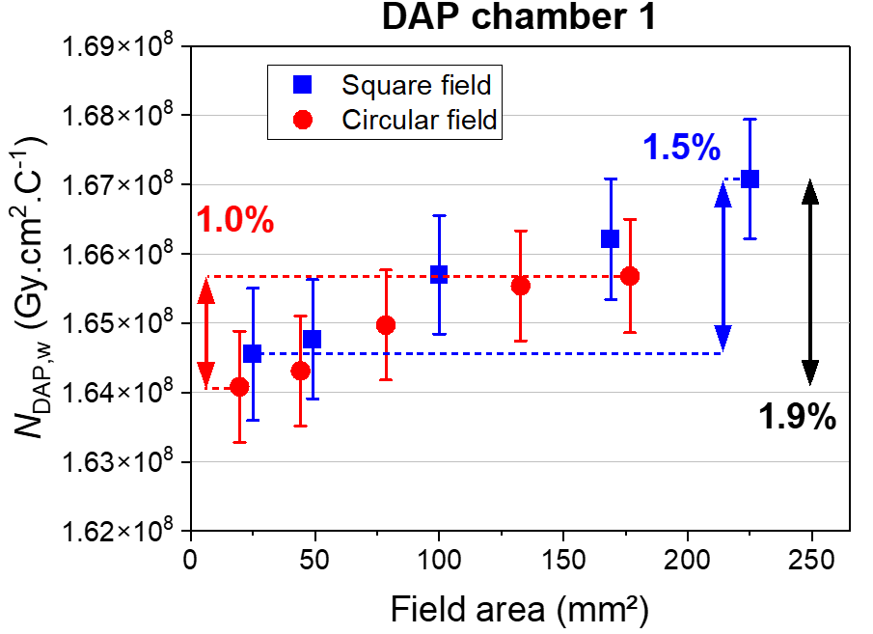
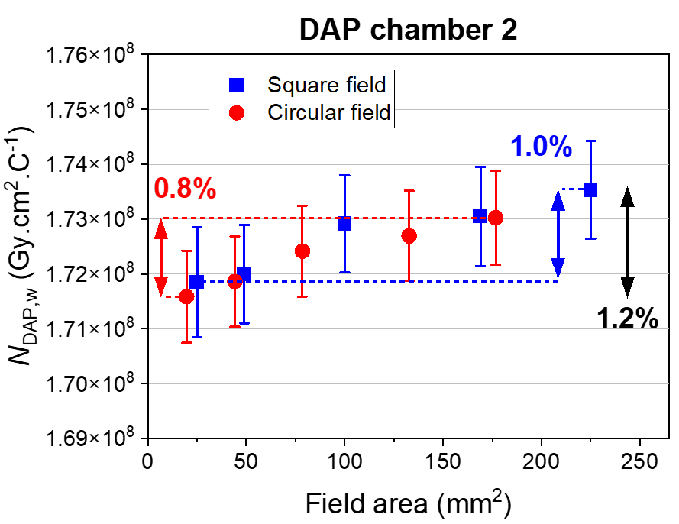
RESULTS – CALIBRATION COEFFICIENTS
Uncertainties at k=1
Small dependency with the field size (max deviation : 1.9%)
Independence with the beam shape (square : blue - circular : red)
Same trend for the 2 chambers

Slide 8
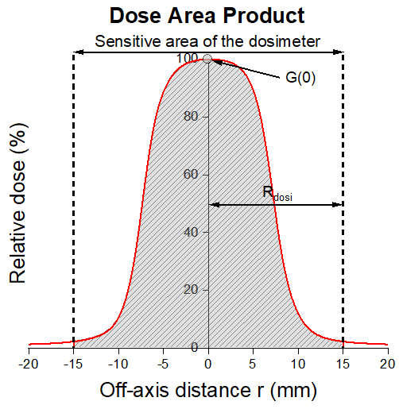
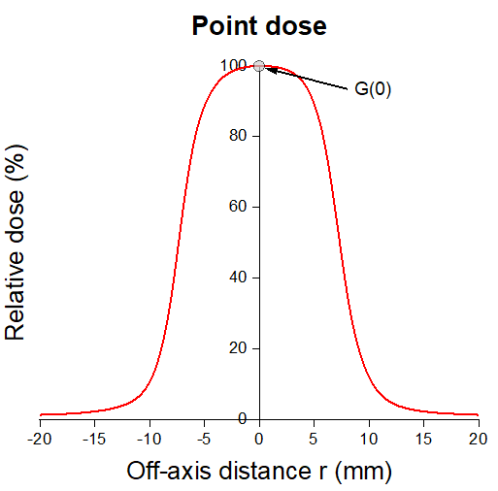
LINK WITH CLASSICAL FORMALISM ?
Determination of point dose via a 2D dose mapping of the beam :
radiochromic films
Correction of volume averaging effect k_{vol}
Absorbed dose on axis integrated on a small enough film area to have a uniform fluence (Gy)
Sensitive area of the dosimeter (cm²)
$$k_{vol}= \frac{G\left(0\right)\iint_{A_{dosi}}^{ }{ⅆxⅆy}}{\iint_{A_{dosi}}^{ }{g(x,y)ⅆxⅆy}}$$
2D dose distribution over the sensitive area of the dosimeter (Gy.cm²)

Slide 9
CONCLUSIONS
First primary standards in terms of DAP established for small fields down to 5 mm
For circular and square field sizes from 5 mm to 15 mm :
Independence of the calibration coefficient with the beam shape
Slight increase of the calibration coefficient with the field size (max deviation : 1.9%)
Reliable link with point dose formalism through primary standards with the experimental DAP + film method

Slide 10
PROSPECTS
Introduction of the DAP + film method in TPS for OF commissioning process
Comparison of the DAP + film method with the TRS 483 approach :
For a set of detectors, validate or invalidate the correction factors
Determination of correction factors for non-tabulated and new detectors
Impact for clinical cases on TPS dose calculation made with the DAP + film method

Slide 11
Thank you for you attention

