Slide 1


Electrochemical behavior of zirconium in molten fluoride
2018 International Pyroprocessing Research Conference
Delphine QUARANTA¹, Eric MENDES¹, Laurent MASSOT², Mathieu GIBILARO², Jérôme SERP¹
¹ CEA Marcoule, Nuclear Energy Division, Research Department on Mining and Fuel Recycling Processes, 30207 Bagnols-sur-Cèze, France
² Laboratoire de Genie Chimique, Université de Toulouse, UPS, CNRS, INPT, 118 Route de Narbonne, 31062, Toulouse Cedex 9, France
Tokai-mura, Ibaraki, Japan, October 24 - 26, 2018

Slide 2

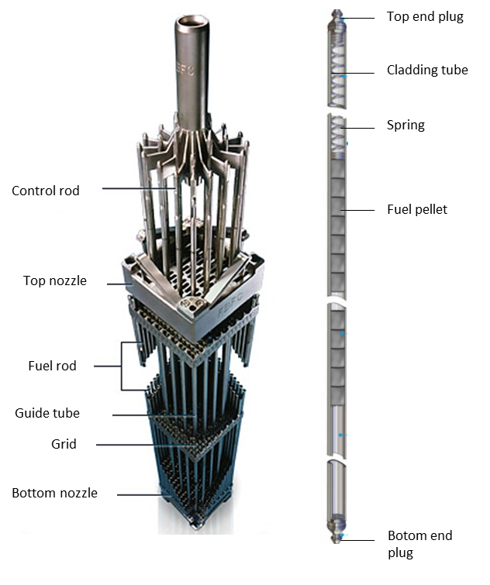
Context
Definition of Zircaloy and composition of irradiated Zircaloy cladding
Zircaloy
  Material constituting nuclear fuel claddings
  Main composition of Zircaloy-4
      Non-irradiated
      Irradiated claddings
Activity coming from:
      βγ elements:
        Fission products (FPs): ³H, ⁹⁰Sr, ¹⁰⁶Ru, ¹³⁷Cs, ¹⁵⁴Eu…
      Activation products (APs): ⁵⁵Fe, ⁶⁰Co, ⁵⁹Ni, ⁹³Zr, ⁹⁴Nb, ¹²¹Sn, ¹²⁵Sb
      α elements: Actinides Am, Pu, Cm, U
  Heterogeneity : distribution of radioelements, nature of elements (metal, oxide, hydrides)
Elements | Content (wt%)
Sn | 1.20 – 1.70
Fe | 0.18 – 0.24
Cr | 0.07 – 0.13
O | 0.09 – 0.16
Zr | ~ 98
Schematic of an assembly of a French nuclear fuel
2018 International Pyroprocessing Research Conference, October 24 - 26, 2018

Slide 3
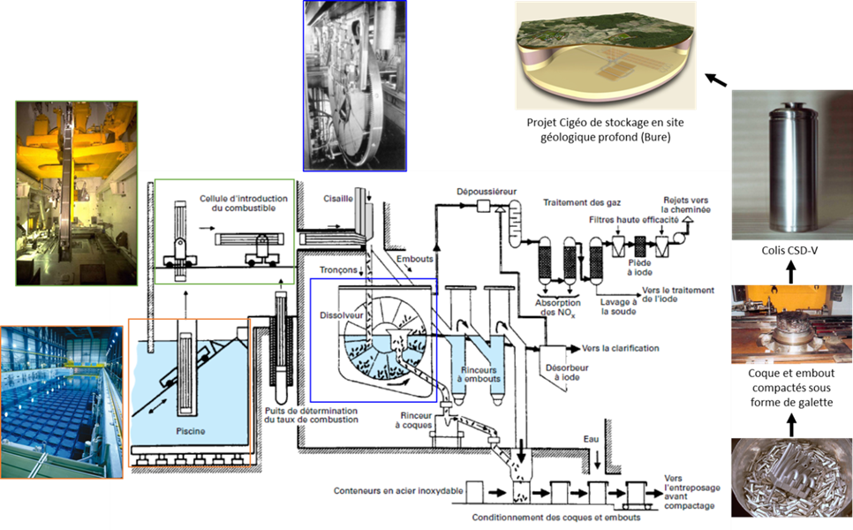
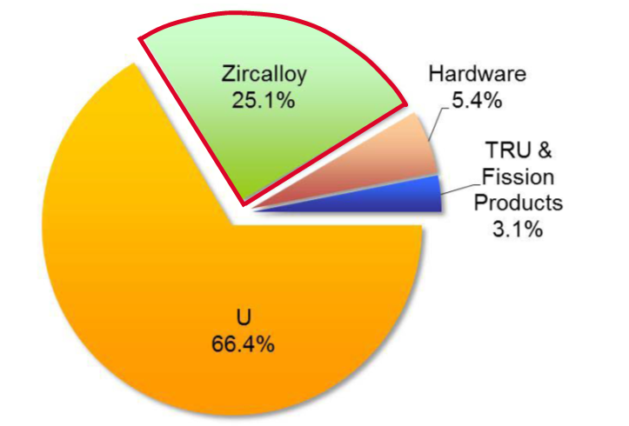
Context
Recycling Zr contained in Zircaloy cladding
Geological long term Repository
  Spent fuel management in France (La Hague reprocessing plant)
      pool storage
      shearing in 3-5 cm section
      dissolution of UO₂ pellet
  Treatment of remaining Zircaloy
  25 wt.% of spent nuclear fuel
Mass compositions of the constituent elements of spent nuclear fuel Collins et al. 2012
First step: fundamental comprehension of electrochemical behavior of Zr in salt
Aim of the study: investigation on potential recycling of Zr from irradiated Zircaloy
  → Re-use of Zr for zircaloy refabrication and/or easier storage
Identification of two promising routes
  Chemical attack at high temperature : chlorination (Collins et al. DOE, USA)
  Electrochemical processes in molten salts : electrorefining
2018 International Pyroprocessing Research Conference, October 24 - 26, 2018

Slide 4
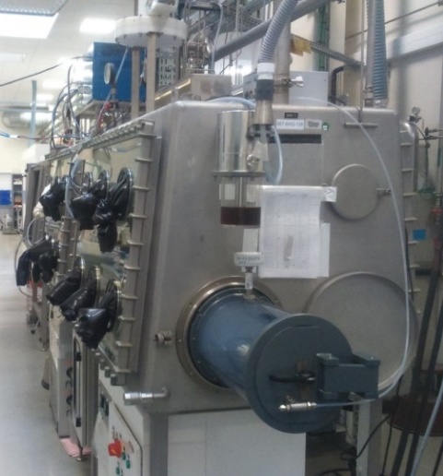
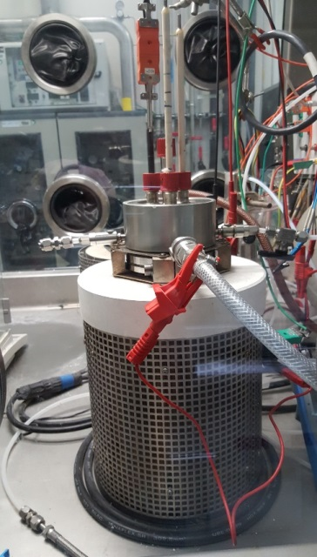
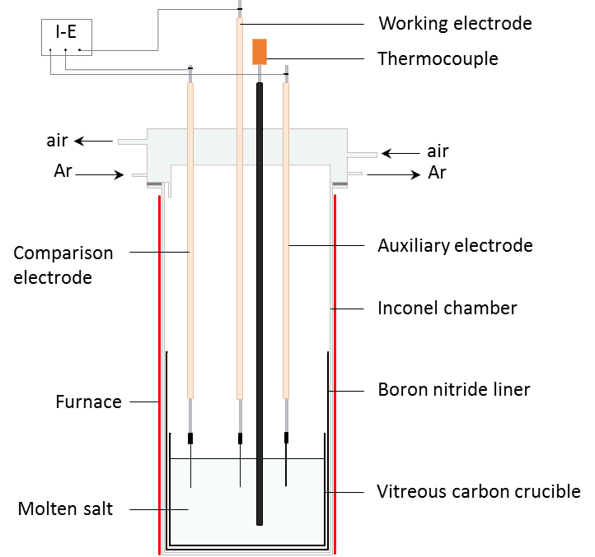
Experimental Setup
Salt media
  Chlorides: several stable oxidation states (0, I, II, IV) of Zr reported in the literature → Not adapted
  Fluorides: should stabilise oxidation state → Eutectic LiF-NaF
Equipment
  Inactive pyrochemistry lab in gloveboxes under Ar atmosphere (< 10 ppm H₂O and < 5 ppm O₂)
Inactive Glovebox
Experimental conditions
  Temperature range 750 – 900°C
  ZrF₄ concentration: 0.2 – 1.5wt%
  Electrochemical behavior and electrocrystallisation process
      Working electrode : Ag wire (1mm Ø)
      Counter electrode : glassy carbon rod (3mm Ø)
      Quasi reference electrode : Pt wire (1mm Ø)
  Electrodeposition
      Cathode : 3 different materials studied (Zr, Graphite, SS)
      Anode : Zr plates
      Quasi reference electrode : Pt wire
Cell description
2018 International Pyroprocessing Research Conference, October 24 - 26, 2018

Slide 5
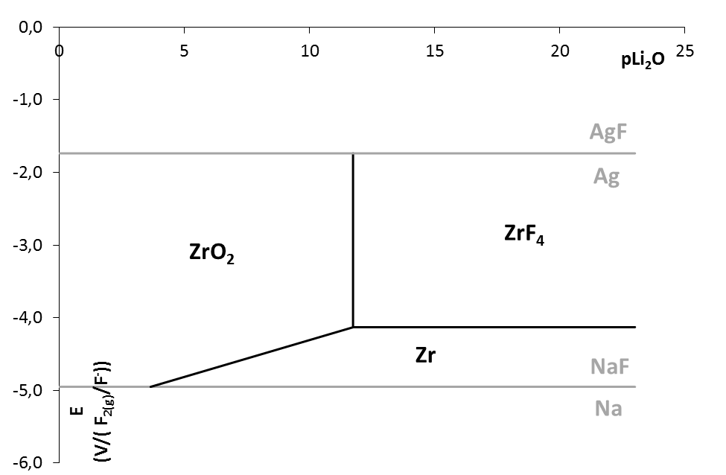
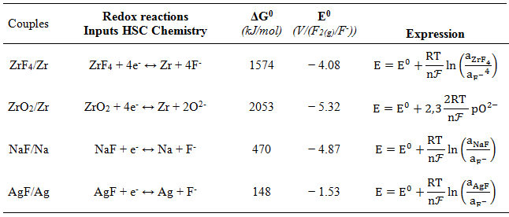
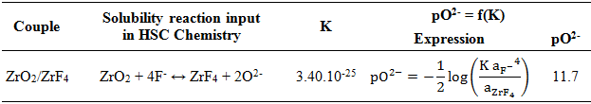
Thermodynamic approach
pO²⁻
  Determination of Pourbaix diagram
      Using HSC® Chemistry database
      Considered species : Zr, ZrF₄ and ZrO₂
      ZrF₄ activity considered: 0.1
      Limits of the diagram : reduction of Na⁺ and oxidation of Ag working electrode
  Influence of pO₂₋ on stability of Zr
    Solubility limit : pKs = 24.5
    → pO²⁻ = 11.7
    Zr very sensitive to presence of O²⁻ in the salt
    Importance of preparation of the salt: avoiding maximum presence of oxide
2018 International Pyroprocessing Research Conference, October 24 - 26, 2018

Slide 6
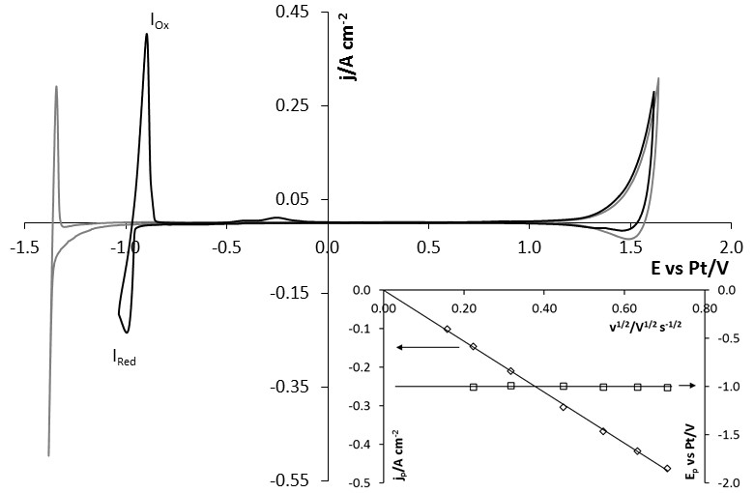
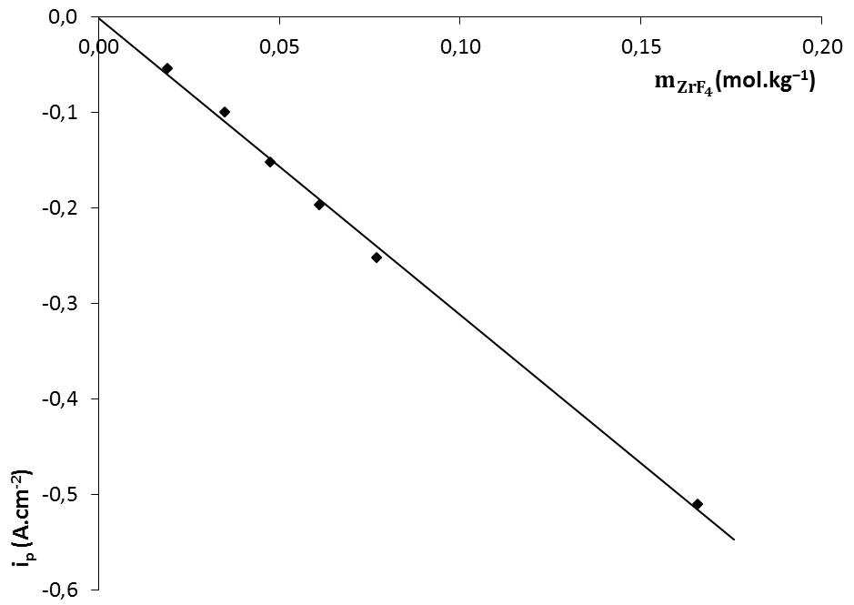
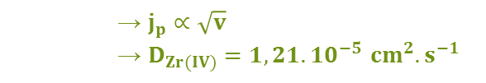





Electrochemical behavior: cyclic voltammetry
$$Zr⟶Zr(IV)$$
$$Ag⟶Ag(I)$$
$$Zr⟵Zr(IV)$$
$$Na⟵Na(I)$$
Variation of current density of the reduction peak as a function ZrF₄ molality , at 750°C and scan rate 100mV.s⁻¹.
Cyclic voltammograms of the LiF–NaF system at 100 mV.s⁻¹ and 750 °C: without ZrF₄ (grey) and with ZrF₄ addition of 0.06 mol.kg⁻¹ (black). Inset. Variation of the peak current density (◊) and the peak potential (□) versus the square root of the potential scan rate. Working electrode: Ag (S = 0.36 cm²); auxiliary electrode: glassy carbon; comparison electrode: Pt
Reduction of Zr(IV) occurs in one step
      → $j_{p}∝\sqrt{v}$
      → $D_{Zr(IV)}=1,21.{10}^{−5 }{cm}^{2}.s^{−1}$
Diffusion coefficient
Reduction is controlled by diffusion of Zr(IV)
Arrhenius type law →
$${\ln{D}}_{Zr\left(IV\right)}=−7.77−\frac{3649}{T}$$
Quasi-reversible system
2018 International Pyroprocessing Research Conference, October 24 - 26, 2018

Slide 7

Electrochemical behavior: square wave voltammetry
Square wave voltammogram of the LiF–NaF–ZrF₄ (m₀ = 0.06 mol.kg⁻¹) at 16 Hz, pulse height: 20 mV, step potential: 2 mV and 750 °C. Inset. Variation of the differential of the peak current density (◊) and the peak potential (□) versus the square root of the frequency. Working electrode: Ag (S = 0.35 cm²); auxiliary electrode: glassy carbon; comparison electrode: Pt
Reduction of Zr(IV) in one step
Number of exchanged electrons
$$W_{1/2}=3.52\frac{RT}{n𝓕}=2W_{L}$$
4 electrons exchange
Soluble/insoluble system
$$Zr\left(IV\right)+{4e}^{−}→Zr$$
2018 International Pyroprocessing Research Conference, October 24 - 26, 2018

Slide 8
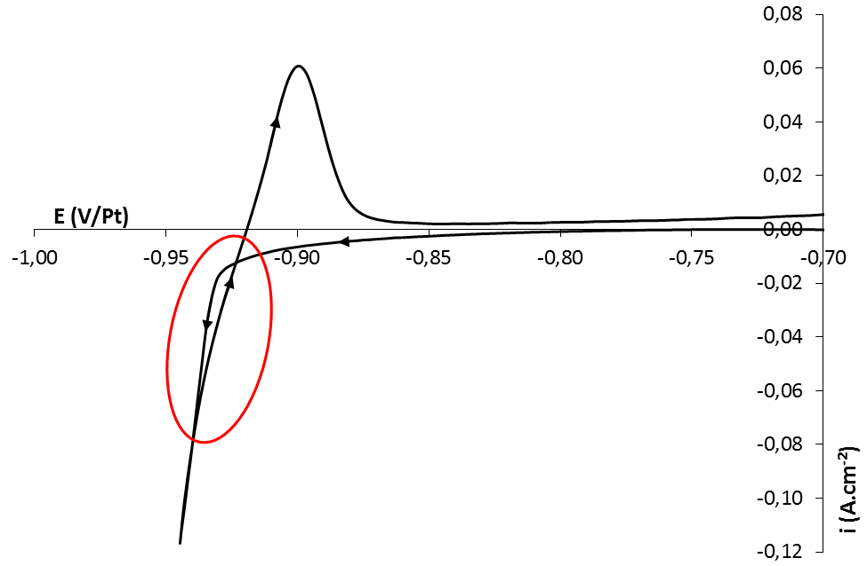
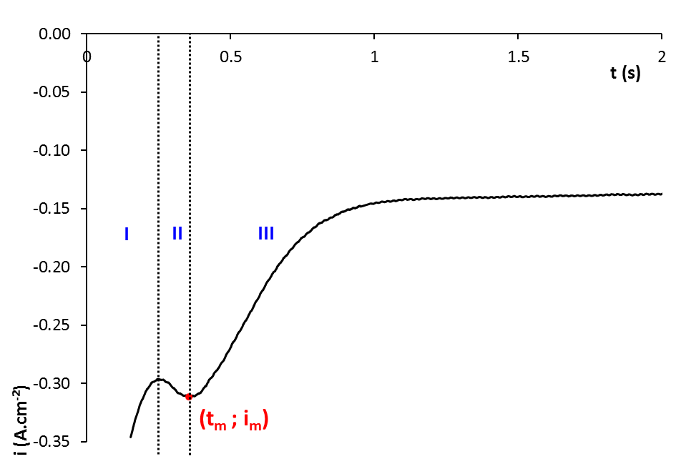

Electrocrystallisation process 1/2
  Crossover on cyclic voltammograms observed: Nucleation process evidenced
Chronoamperometry → 3 areas:
  Part 1: charging of the double layer and the formation of the first germs
  Part 2: growth of the crystals
  (t_{m} ; j_{m}) → v_{diffusion} = v_{growth crystals}
  Part 3: limitation of the reaction by the diffusion of Zr(IV) ions
Chronoamperogram on silver electrode at η = −0.969V vs Pt in LiF–NaF–ZrF₄ (m₀ = 0.17 mol.kg⁻¹) at 690 °C.
Working electrode: Ag (S = 0.35 cm²); auxiliary electrode: glassy carbon; comparison electrode: Pt
Non-dimensional models : ${\left(\frac{I}{I_{m}}\right)}^{2}=f\left(\frac{t}{t_{m}}\right)$
2018 International Pyroprocessing Research Conference, October 24 - 26, 2018

Slide 9
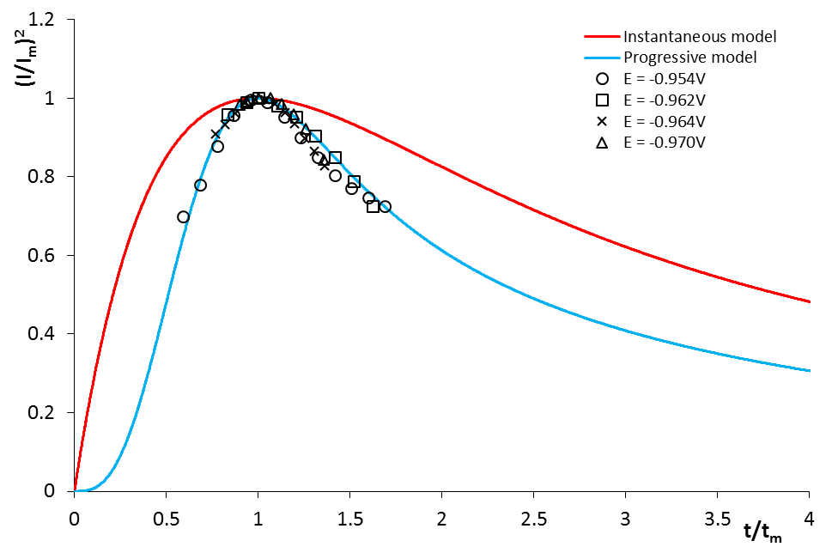
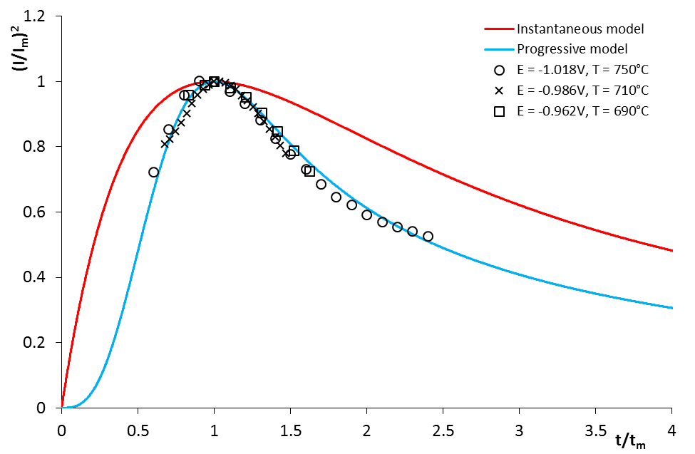
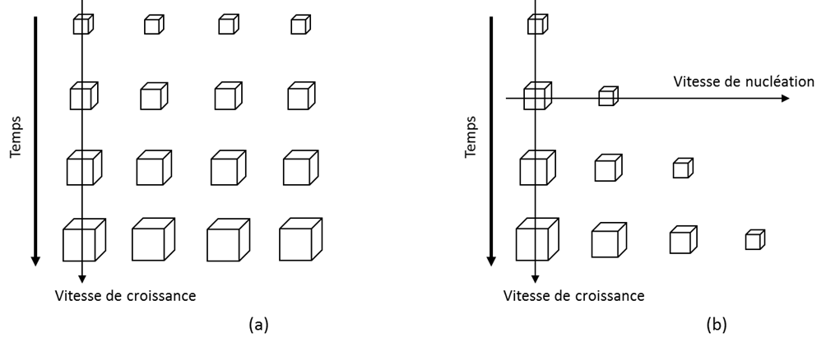
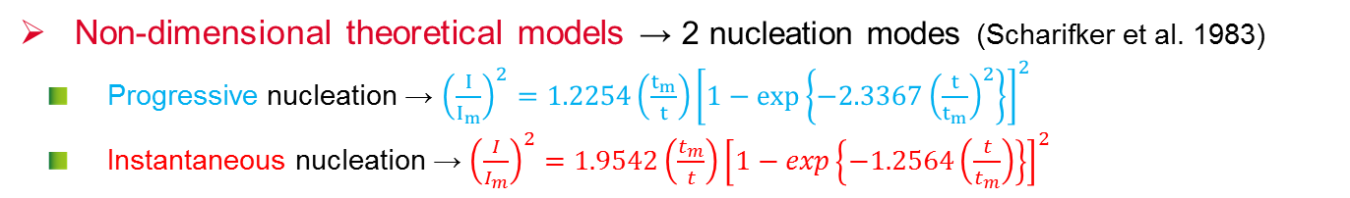
Electrocrystallisation process 2/2
Non-dimensional theoretical models → 2 nucleation modes (Scharifker et al. 1983)
  Progressive nucleation → ${\left(\frac{I}{I_{m}}\right)}^{2}=1.2254\left(\frac{t_{m}}{t}\right){\left[1−exp\left\{−2.3367{\left(\frac{t}{t_{m}}\right)}^{2}\right\}\right]}^{2}$
  Instantaneous nucleation → ${\left(\frac{I}{I_{m}}\right)}^{2}=1.9542\left(\frac{t_{m}}{t}\right){\left[1−exp\left\{−1.2564\left(\frac{t}{t_{m}}\right)\right\}\right]}^{2}$
Nucleation speed
Time
Time
Growing speed
Growing speed
Instantaneous Progressive
Comparison of the dimensionless experimental data obtained from the current-time transients at various overvoltages and temperature with the theoretical models for instantaneous and progressive nucleation in LiF–NaF–ZrF₄ (m₀ = 0.17 mol.kg⁻¹).
Working electrode: Ag; auxiliary electrode: glassy carbon; comparison electrode: Pt
Progressive nucleation mode whatever the overvoltage imposed and the working temperature
Cristal growth in the three dimensions and limited by the diffusion of Zr(IV) ions
Progressive nucleation: high temperature, high concentration and high overvoltage → best deposit conditions
2018 International Pyroprocessing Research Conference, October 24 - 26, 2018

Slide 10
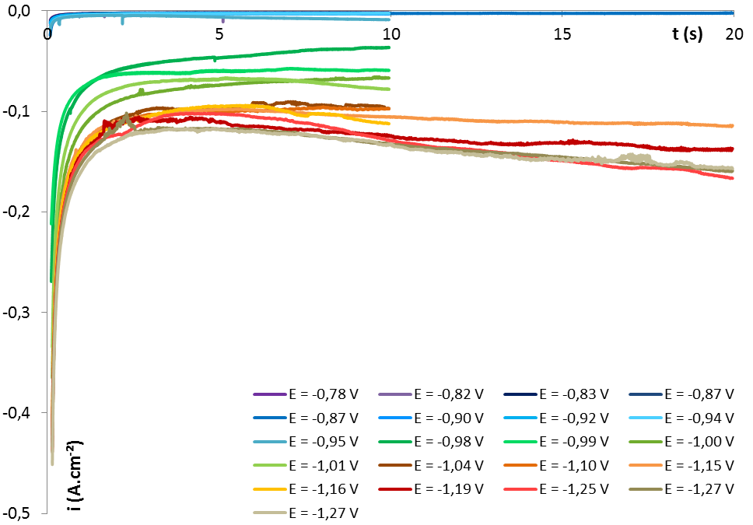
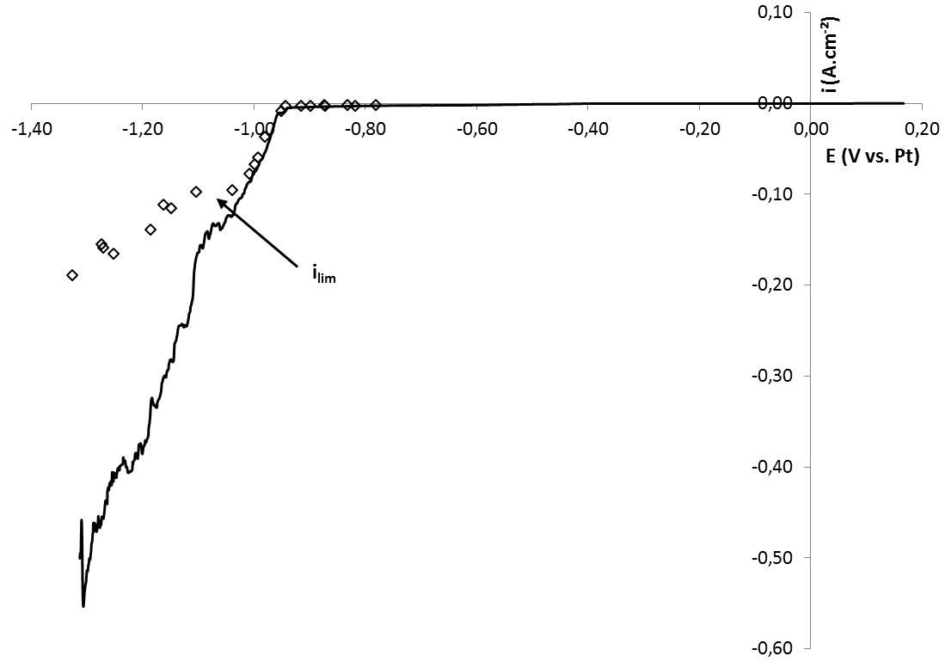
Electrodeposition of ZR 1/4
  Determination of the limiting current
      Fluoride media : No reference electrode
      ⇒ Galvanostatic electrodeposition
      System limited by Zr diffusion
    ⇒ Determination of the limiting current needed
    Tow technics: Voltammetry (low scan range) or polarisation
Chronoamperograms on LiF-NaF-ZrF₄ (C = 7.46.10⁻²mol/kg) at 750°C different applied potentials.
i_{lim} = -0,097A.cm⁻²
i_{lim} = -0,14A.cm⁻².wt%⁻¹
Higher applied current densities:
→ possible co-reduction of Na⁺
Linear Voltamperogram on LiF-NaF-ZrF₄ (C = 7.46.10⁻²mol/kg), scan range: 1mV/s at 750°C and polarisation plots.
2018 International Pyroprocessing Research Conference, October 24 - 26, 2018

Slide 11
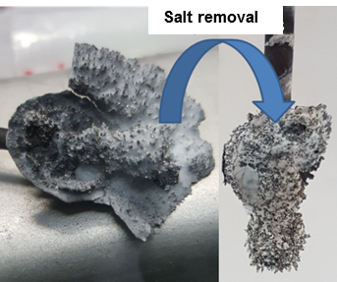
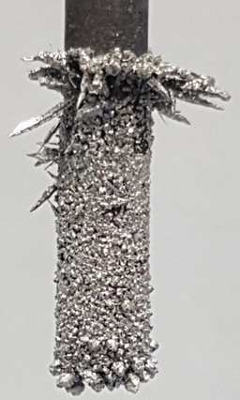
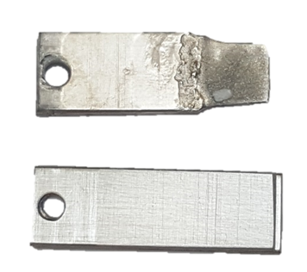
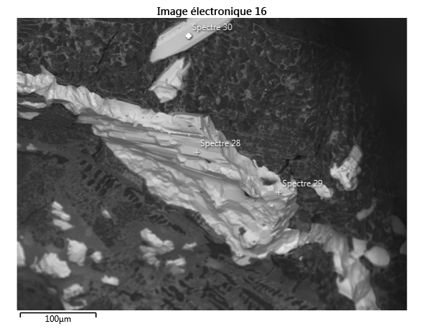
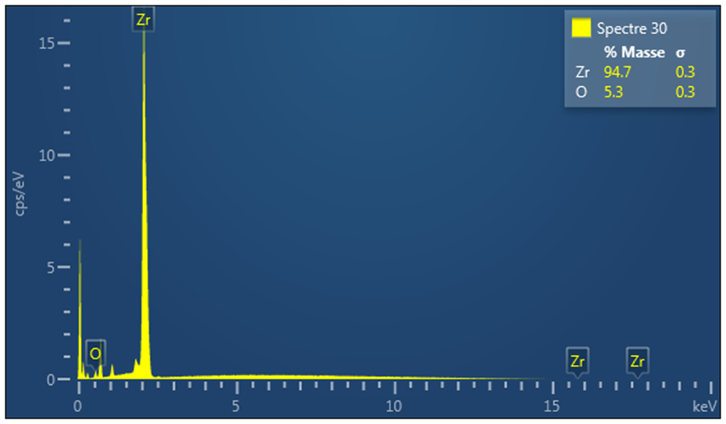
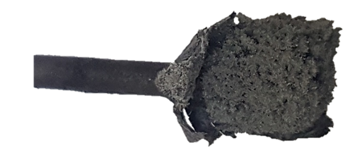
Electrodeposition of Zr 2/4
Cathodes : Zr, C or stainless steel
Anode Zr
Electrodeposition experimental results:
Deposit loss can be observed on several experiments
Important faradic yields reached > 80%
Difficulties to estimate it (salt remaining removal)
Dendritic aspect
Consumption
Zr metal
SEM analysis of Zr deposited on graphite electrode in LiF-NaF-ZrF₄
(C = 0.55 mol.kg⁻¹) at 750°C, J = – 0.72 A.cm⁻²
Feasibility of pur Zr metal deposition demonstrated in LiF-NaF
2018 International Pyroprocessing Research Conference, October 24 - 26, 2018

Slide 12
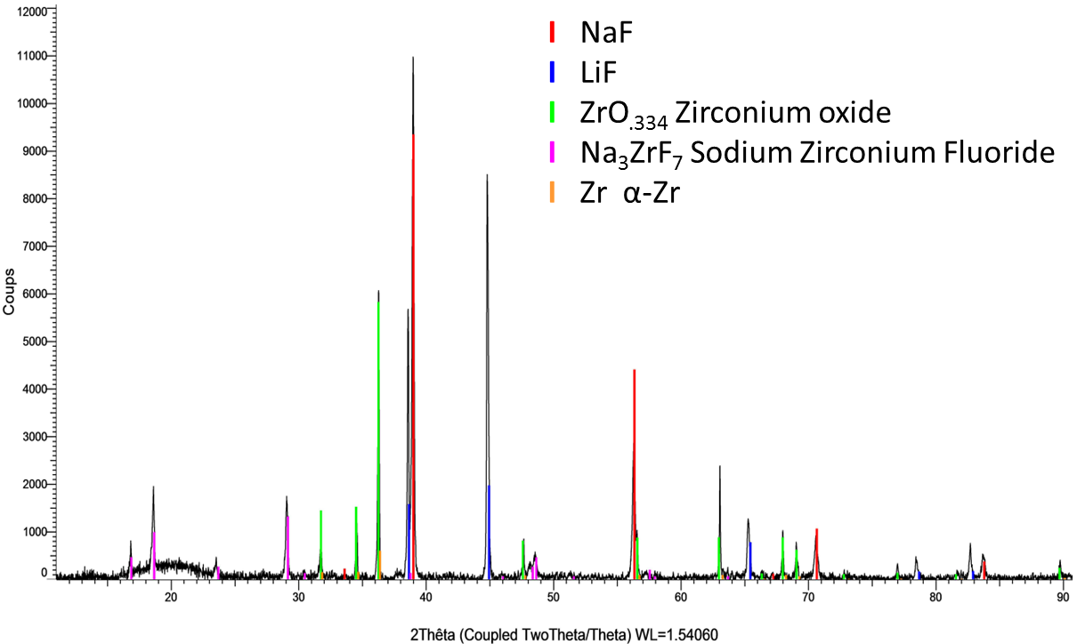
Electrodeposition of Zr 3/4
XRD analysis:
  Confirmation of the SEM analysis
  Residual salt adhered onto the electrode
  Presence of oxygen: contamination of the deposit during sample preparation (under air atmosphere)
2018 International Pyroprocessing Research Conference, October 24 - 26, 2018

Slide 13
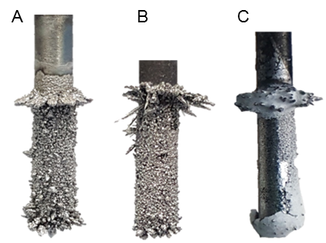
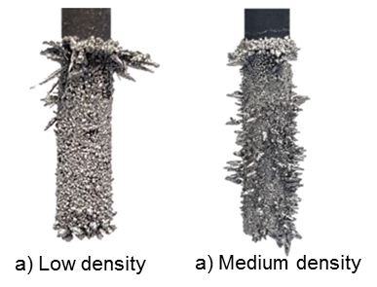
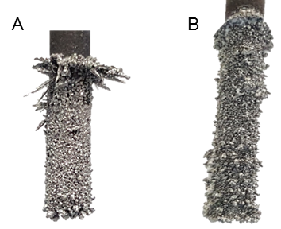


Electrodeposition of Zr 4/4
Influence of the operating parameters
Substrate of cathodes
Current density
ZrF₄ concentration
Zr
C
SS
Deposit loss
Photographs of cathodes after electrolysis runs in
LiF–NaF–ZrF₄ at different current density
Photographs of cathodes after electrolysis runs at in LiF–NaF–ZrF₄ at different molality (C_{A} > C_{B})
Photographs of cathodes after electrolysis runs in
LiF–NaF–ZrF₄ on different substrate
Strong effect of current density on the regularity
Moderate influence of concentration on the regularity
Dense, compact and adherent deposit on Zr and C cathodes
↑ current density $⇒$ ↑ nuclei formed
↑ concentration $⇒$ ↑ nuclei formed
Selection of the cathode material
In good agreement with the Zr nucleation study
2018 International Pyroprocessing Research Conference, October 24 - 26, 2018

Slide 14
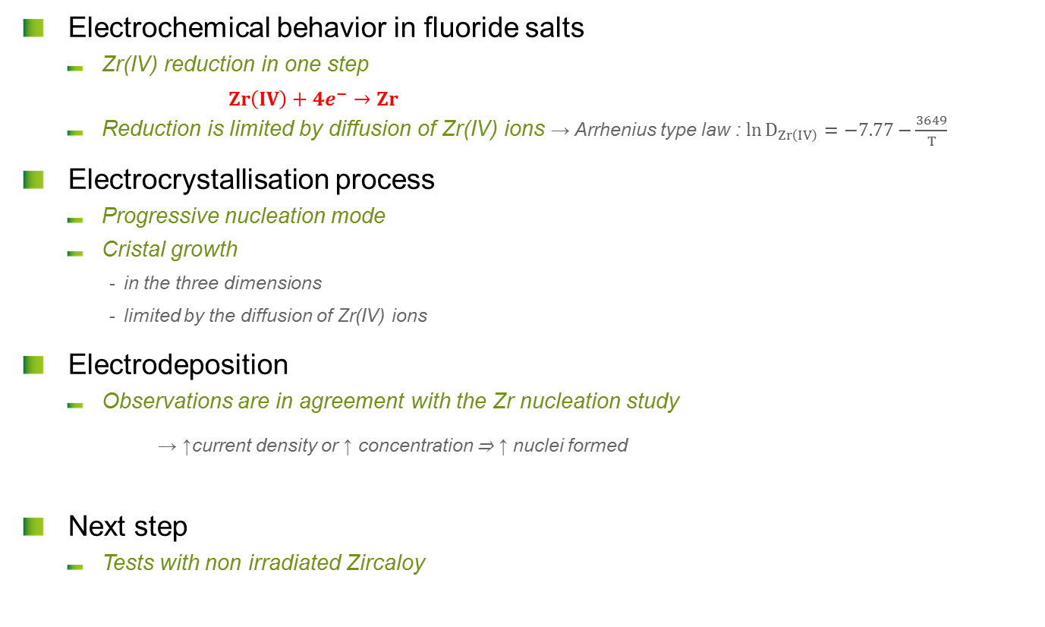
Conclusions and prospects
  Electrochemical behavior in fluoride salts
      Zr(IV) reduction in one step
        $Zr\left(IV\right)+{4e}^{−}→Zr$
      Reduction is limited by diffusion of Zr(IV) ions → Arrhenius type law : ${\ln{D}}_{Zr\left(IV\right)}=−7.77−\frac{3649}{T}$
  Electrocrystallisation process
      Progressive nucleation mode
      Cristal growth
        in the three dimensions
        limited by the diffusion of Zr(IV) ions
  Electrodeposition
      Observations are in agreement with the Zr nucleation study
      → ↑current density or ↑ concentration ⇒ ↑ nuclei formed
  Next step
      Tests with non irradiated Zircaloy
2018 International Pyroprocessing Research Conference, October 24 - 26, 2018

Slide 15
DEN
DMRC
SPDS
LDPS
Thank you for your attention
Acknowledgments:
Pierre CHAMELOT (LGC Toulouse)
Nicolas MASSONI (CEA Marcoule)
David RUDLOFF (CEA Marcoule)
Commissariat à l’énergie atomique et aux énergies alternatives
Centre de Marcoule | 30207 Bagnols sur Cèze
T. +33 (0)4 66 79 62 51 | F. +33 (0)4 66 79 65 67
  Etablissement public à caractère industriel et commercial | RCS Paris B 775 685 019

